Slide 1
Shine Bright Like a Diamond
Gage Stout, Jessica Fernandez, Jovany Calendario, Lorelei Wong, Rafael Brennand and Travis Molnoskey
Notes:
Travis

Slide 2
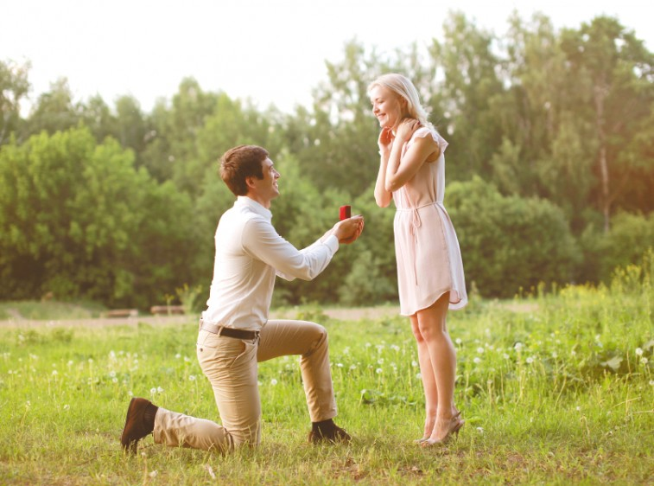
The big decision
So you decided on getting married. Congrats!! But first, you need to get that bling to ask your partner to marry you.
Let’s get on the internet then...
Notes:
Travis

Slide 3
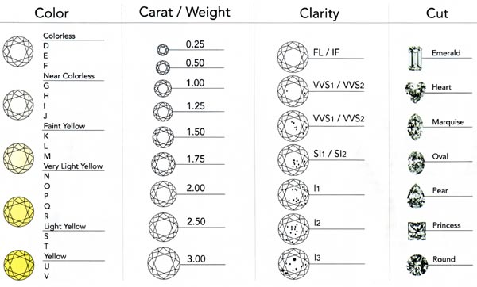
Which to pick?
You go online and then you get bombarded with so many different options to choose from. So you start getting your pick to select the perfect ring.
Notes:
Gage

Slide 4

Can I afford it?
You defined your perfect diamond with the Carat, Cut, Clarity and Color but will it fit your wallet?
Notes:
Gage

Slide 5
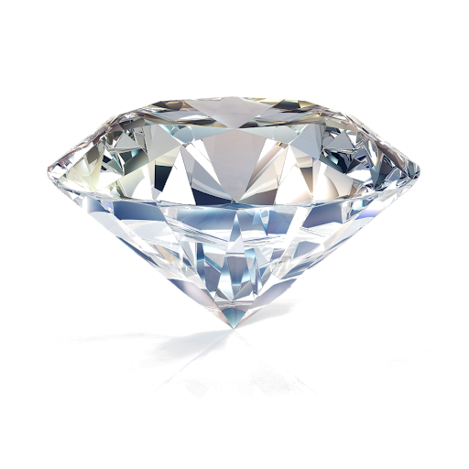




PROJECT STRUCTURE
DATA
MACHINE
LEARNING
SERIALIZE
ML
GUI
DESERIALIZE
ML
Notes:
Jessica

Slide 6
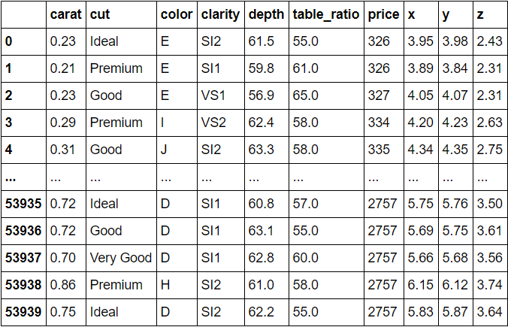
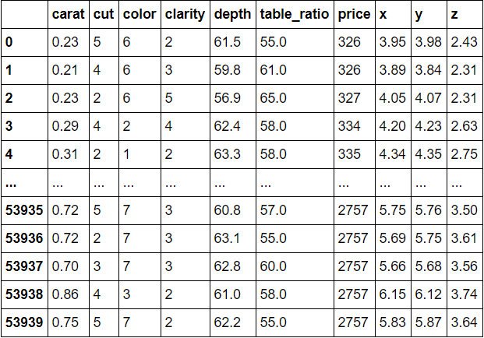
Data Transformation
Notes:
Rafa

Slide 7
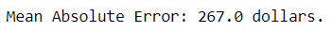
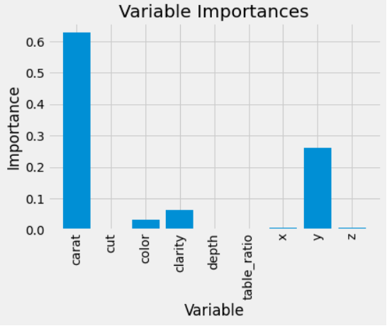
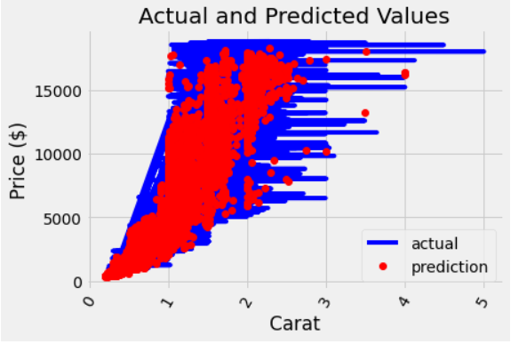
Random Forest Model
Notes:
Rafa

Slide 8
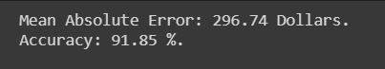
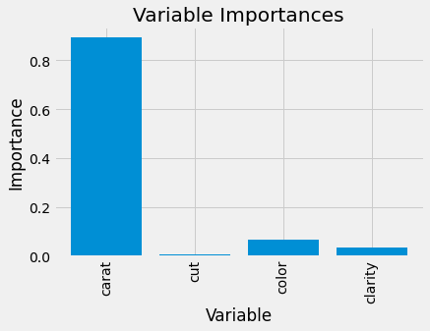
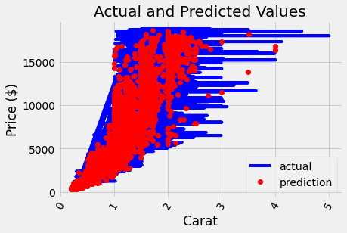
Random Forest Model
Notes:
Rafa

Slide 9
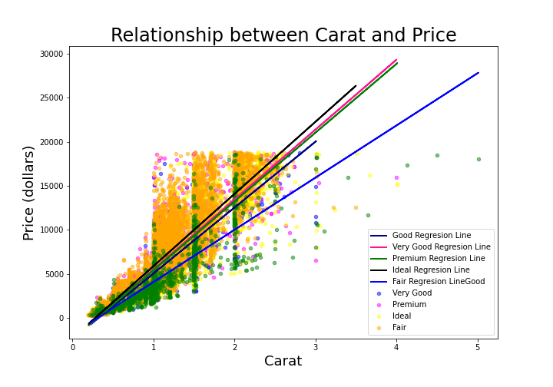
How Much does the Cut of a Diamond Actually Matter?
Not much actually. While there is an obvious difference in price based on the cut you buy, the slope of the lines seem to be similar.
The only cut that does seem to have a substantial difference in slope based on cut is a fair cut
Notes:
Jovany

Slide 10
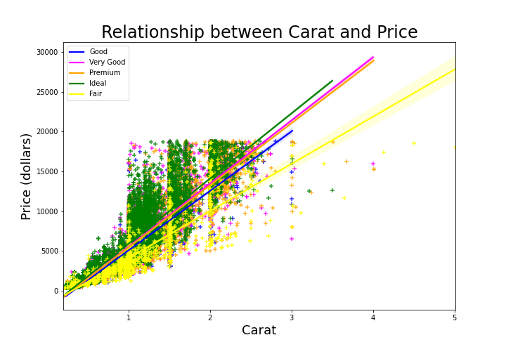
Continuing with Fair Cuts...
Using seaborn, we see that only one regression line has bars that represent the uncertainty of the estimate
That regression line would be the Fair Fit Regression Line, revealing that it may have an even smaller effect on price than previously believed

Slide 11
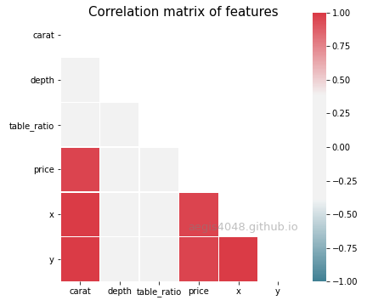
Correlations of Variables
Examining the table, we see continue to see that depth and table_ratio do not have an sort of correlation with any other variable.
This also certifies our point that the dimensions of the diamond correlate positively to the price of the diamond
Notes:
Jovany

Slide 12

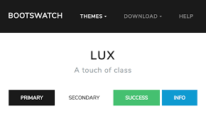
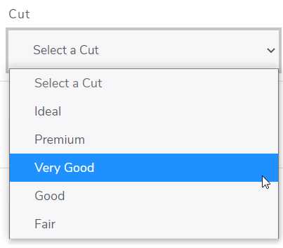
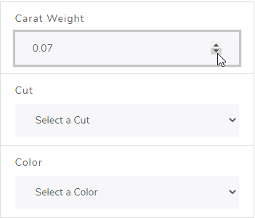
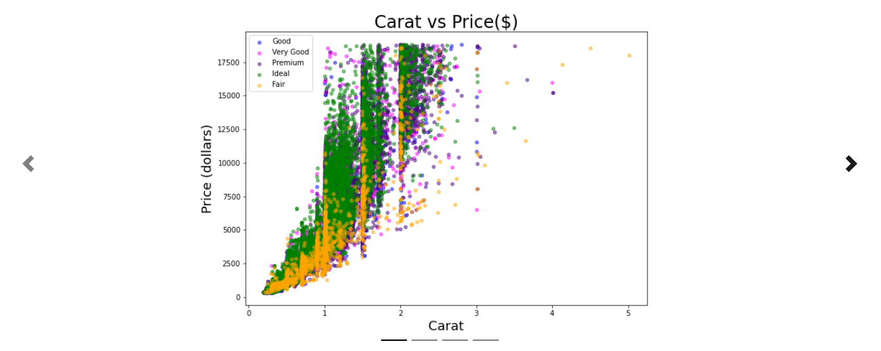
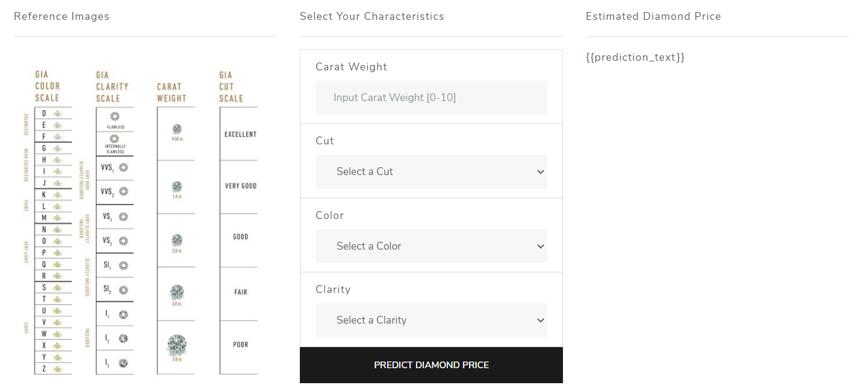


Webpage
Notes:
Lorelei

Slide 13
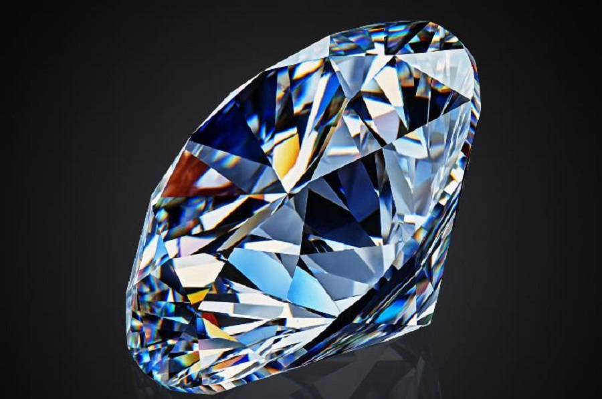
Questions? Comments?

